Slide 1

Hawaii's Airbnb Landscape:
Insights and Analysis ​​
Hawaii's Airbnb Landscape:
Insights and Analysis ​​​
Team Members:
Jose Davila
Diana De los Santos
RAE ANN GREGG
Marc Huerta
Emilia Sanchez
Notes:
Rae Ann

Slide 2


Our Motivation
Our Motivation
Discovering places to stay in Hawaii
Inspired by what we learned in our previous Project, we decided to expand our scope to all of Hawaii!
With a fascination for the aloha state, we ventured on to uncover further listing details, host ratings and preferred property types. Following suit over our previous project, we set our sights on unraveling the full details of Airbnb super hosts across the islands.
Using machine learning, we peered into the future to predict which hosts might achieve super host status. Armed with data and determination, we deep dived into the world of Airbnb in Hawaii, painting our visualizations in Tableau and getting our questions answered.
We also made some changes and updates to our website reflecting Hawaii's beauty and charm!
Notes:
Rae Ann

Slide 3




Hawaiian Culture
Aloha
Why is Hawaii known as the Aloha state?
"Aloha" is the essence of relationships in which each person is important to one another as a collective whole.
It describes the Hawaiian Islands, the spirits the spirits that inhabit them, the forces of nature that shaped them and how they are all connected.
Before we can arrive in paradise we needed to figure out where we wanted to stay. Our first step is looking over all the listings for Airbnbs in Hawaii!

Slide 4

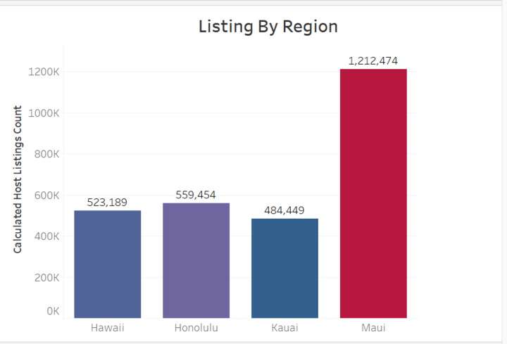
Distribution of Listings By Region
Distribution of Listings By Region​
Hawaii encompass numerous key islands, each with their own distinct features and attractions.
Here is an overview on the following regions Hawaii.
There is a lot of options to choose from!
Oahu
Tableau

Slide 5

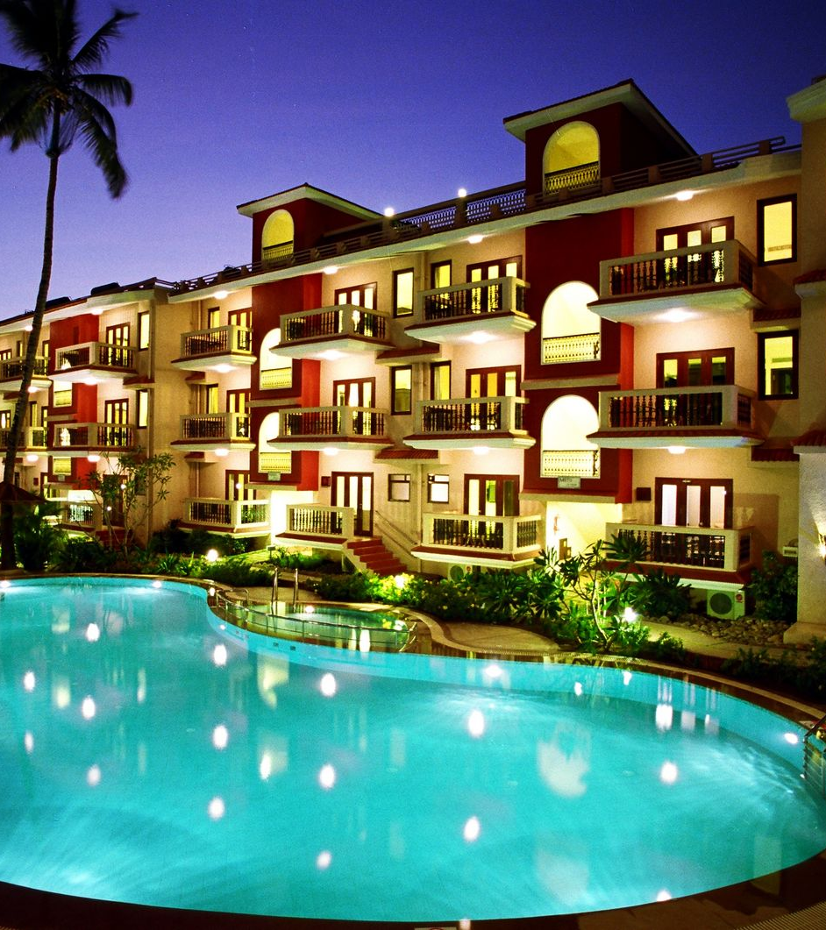
Factors to consider when looking for the right Airbnb
Factors to consider when looking for the right Airbnb Include
Include​ :
When is the best time to book a reservation?
What are the differences between a host vs a super host?
When is the best time to book a reservation?
What are the differences between a host vs a super host?

Slide 6

What Makes a Super Host Stand Out?
Every 3 months, each host is evaluated on their hospitality they must meet all the following criteria—they’re highly rated, experienced, reliable, and responsive.
Maintains a remarkable 4.8+ overall rating.
Boasts a minimum of 10 stays, showcasing extensive hosting experience.
Demonstrates reliability with a cancellation rate of less than 1%.
Maintains a 90% response rate, ensuring swift assistance to guests.
https://public.tableau.com/app/profile/diana.de.los.santos/viz/Project4_17109871260380/HawaiiAirBNBAnalysis?publish=yes​
https://www.airbnb.com/d/superhost-guest#:~:text=Being%20an%20Airbnb%20Superhost%20is,and%20often%20exceeding%2C%20guest%20expectations
Notes:
Diana -

Slide 7
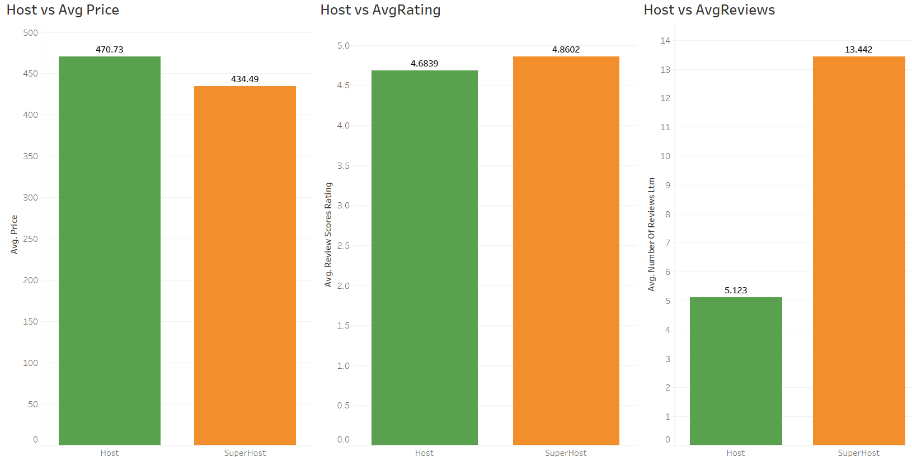
Super Host vs. Host
Host vs Avg Price
Host vs Avg Rating
Host vs Avg Reviews
Super Host rentals have a lower average cost
Super Hosts rentals have a higher average rating
Super Host rentals have significantly more reviews than other rentals
https://public.tableau.com/app/profile/diana.de.los.santos/viz/Project4_17109871260380/HawaiiAirBNBAnalysis
https://www.airbnb.com/d/superhost-guest#:~:text=Being%20an%20Airbnb%20Superhost%20is,and%20often%20exceeding%2C%20guest%20expectations
Notes:
Diana -

Slide 8
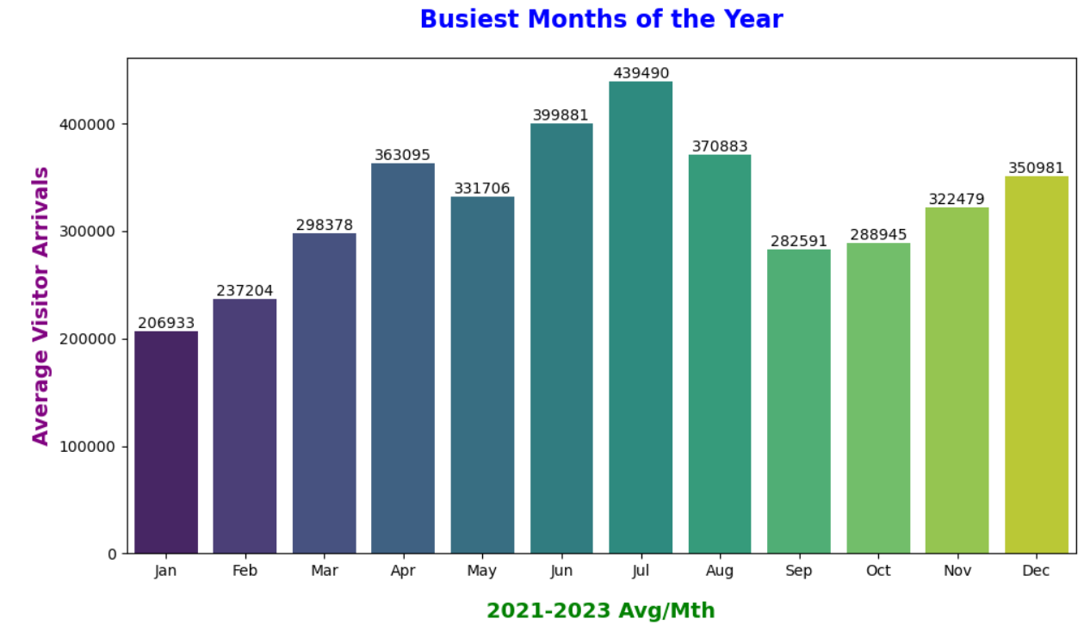
https://data.uhero.hawaii.edu/dvw/#/module/trend
Notes:
Diana - The optimal period for visiting Hawaii spans from March to September, marked by the highest temperatures and minimal rainfall. According to insights from Hawaii Tourism, July stands out as the busiest arrival month, while January takes the lead as the quieter period for visitors.

Slide 9
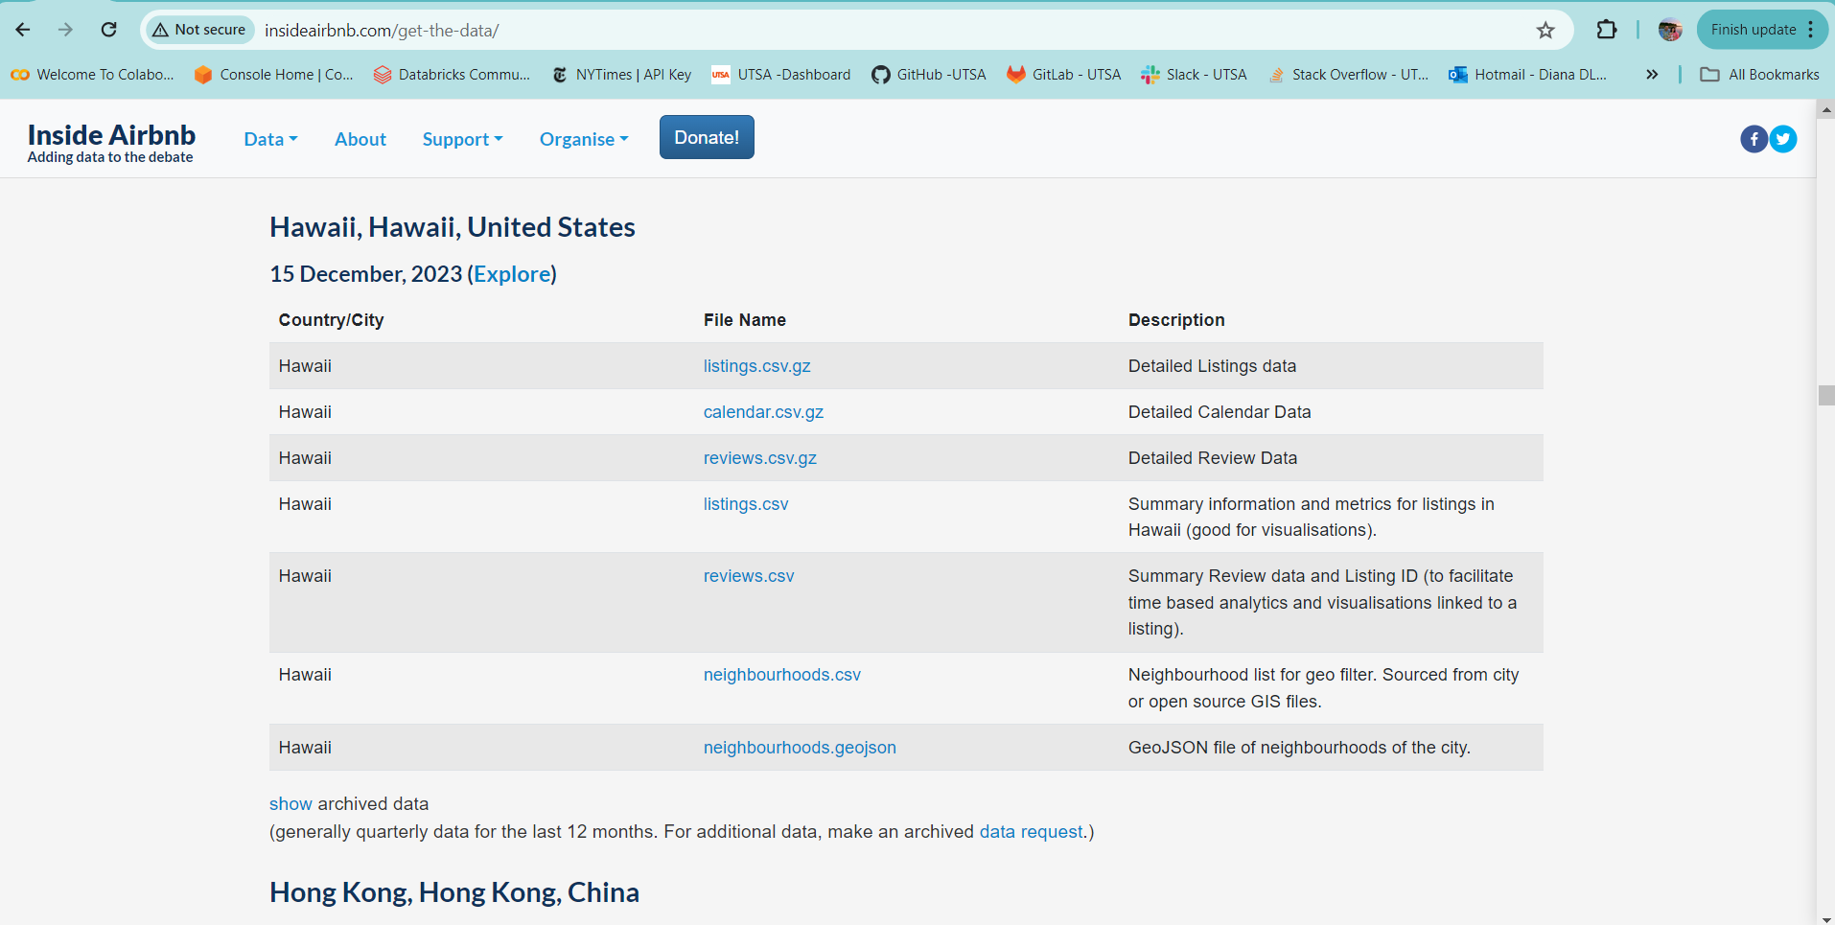
Data Source: Inside Airbnb​
Data Source: Inside Airbnb
​
Inside Airbnb
Detailed Data included
Price
Availability
Host details
Accommodation details
Ratings
Neighborhoods
Response rates
http://insideairbnb.com/get-the-data

Slide 10
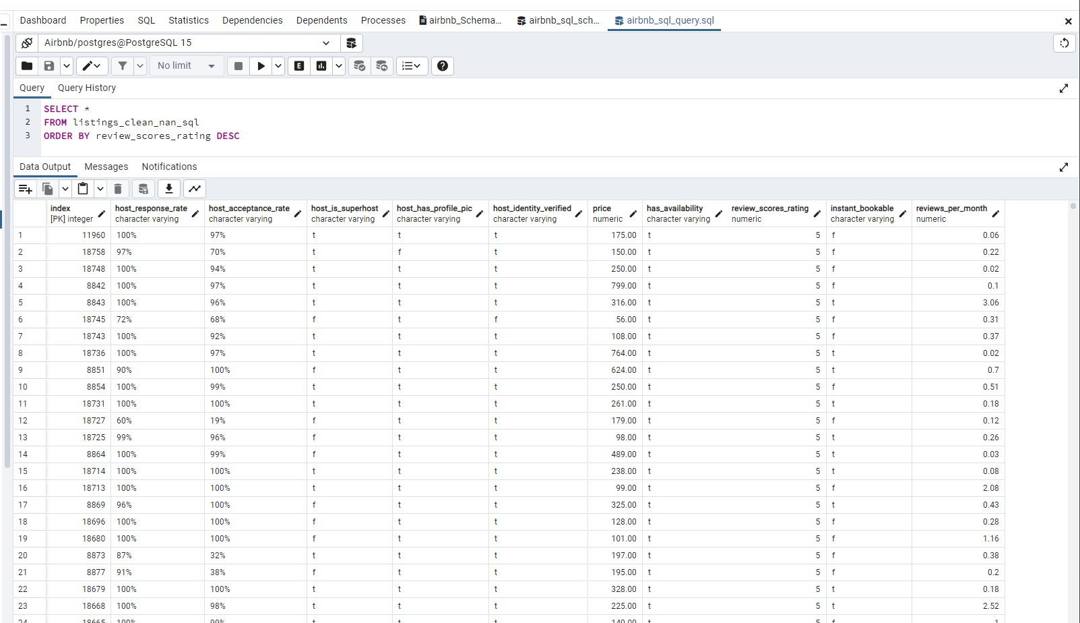
SQL Table​
SQL Table
SQL Data Review
61 Columns
Over 34,000 Rows
Columns Include
Host ID
Host Name
Host Response Rate
Host Acceptance Rate
Super Host
Price
Availability
Review Scores Rating
Reviews per Month
Notes:
Rae Ann

Slide 11
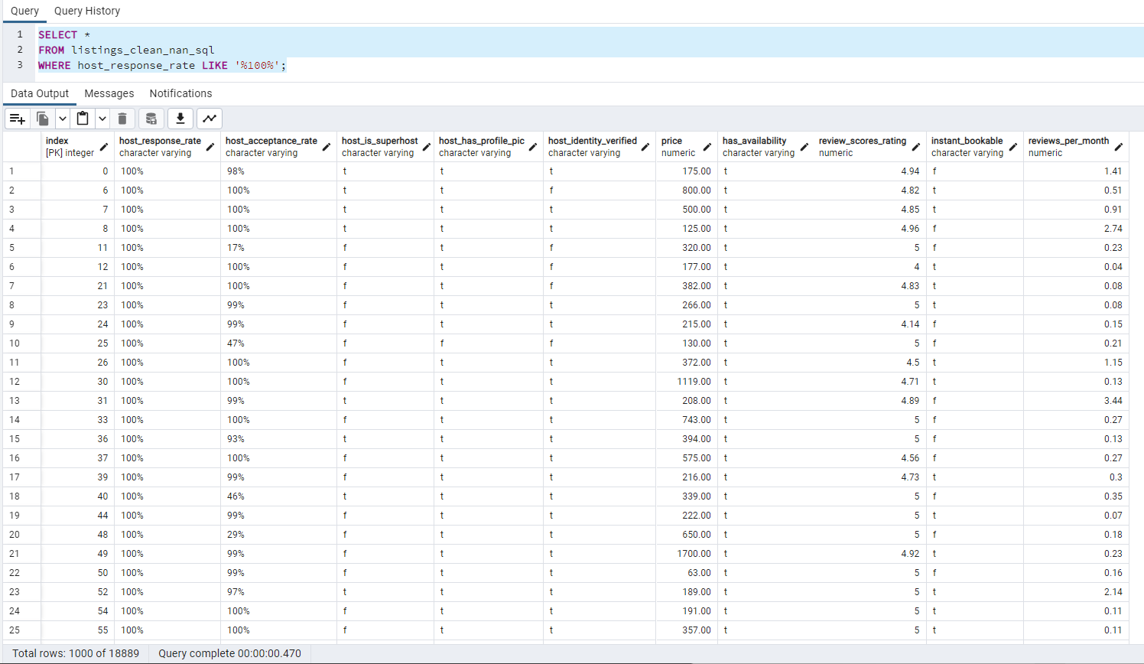
SQL Query
SQL Query
SQL Data Review
Columns Include
Host ID
Host Name
Host Response Rate
Host Acceptance Rate
Super Host
Price
Availability
Review Scores Rating
Reviews per Month
Notes:
Rae Ann

Slide 12


Neural Network Model
Neural Network Machine Learning used to predict
Super Hosts
Notes:
Emilia

Slide 13
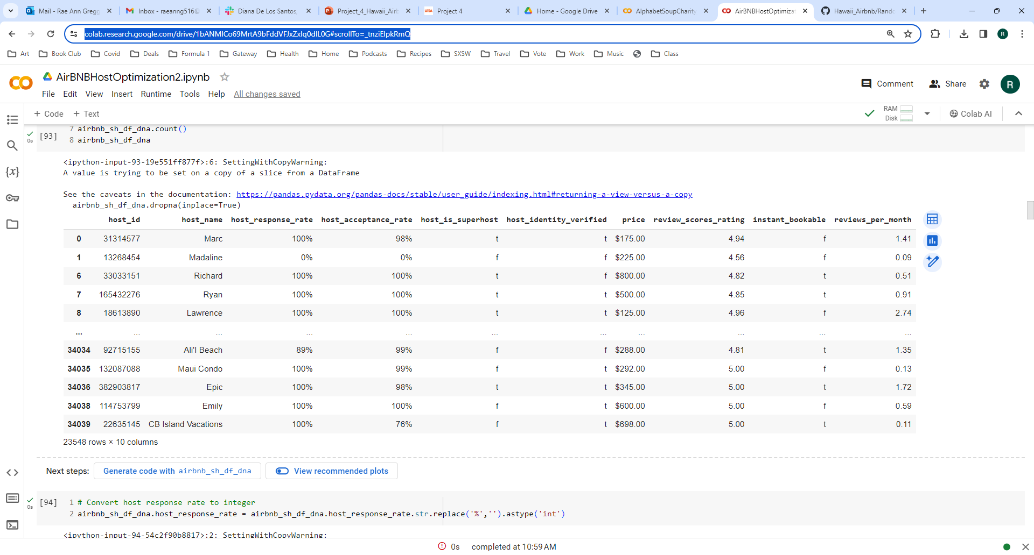
Neural Network Model
Neural Network Model
Features
Host Response Rate
Host Acceptance Rate
Host Profile Pic
Host Identity Verified
Price
Availability
Review Scores Rating
Instant Bookable
Reviews per Month
Target Feature – Super Host
Notes:
Rae Ann

Slide 14
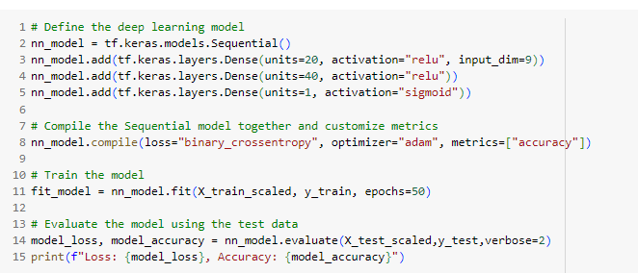
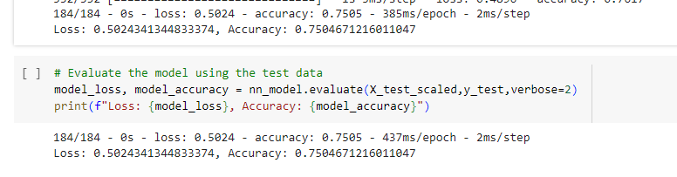
Neural Network - 3 Layers - Achieved 75% Accuracy
First Model
9 features
3 layers
1st layer – 20 neurons
2nd layer – 40 neurons
Final layer – 1 neuron
50 epochs
Notes:
Rae Ann

Slide 15
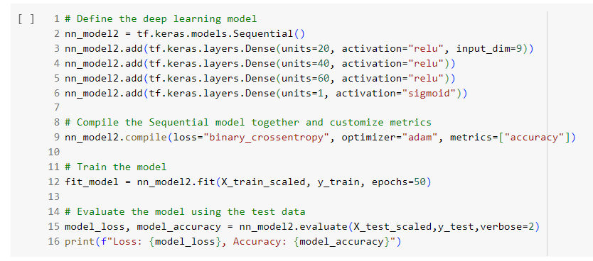
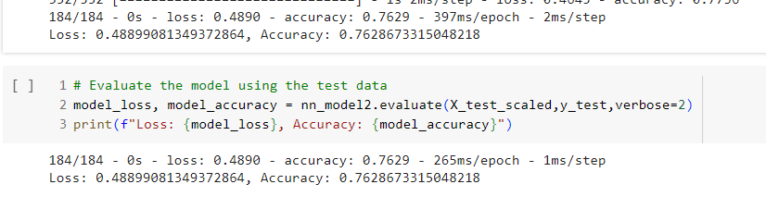
Neural Network – 4 Layers - Achieved 76% Accuracy
2nd Model
9 features
4 layers
1st layer – 20 neurons
2nd layer – 40 neurons
3rd layer – 60 neurons
Final layer – 1 neuron
50 epochs
Notes:
Rae Ann

Slide 16
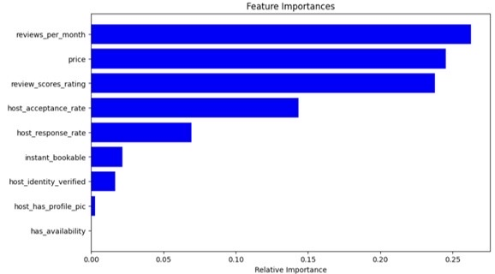
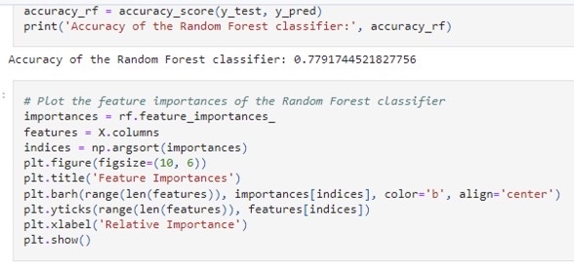
Neural Network – Random Forest
Achieved 78% Accuracy
4th Model
Random Forest
Used default values
9 features
Notes:
Rae Ann

Slide 17
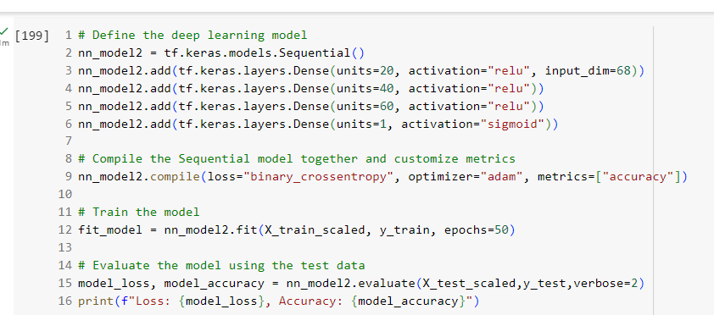
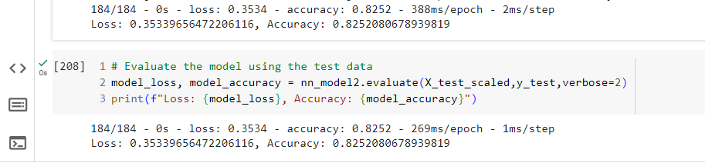
Neural Network – Added Host ID / Removed Features
Achieved 82% Accuracy
5th Model
Included Host ID
Binned Host ID – over 50 Rentals
Removed host profile pic
Removed availability
8 features
4 layers
1st layer – 20 neurons
2nd layer – 40 neurons
3rd layer – 60 neurons
Final layer – 1 neuron
50 epochs
Notes:
Rae Ann

Slide 18
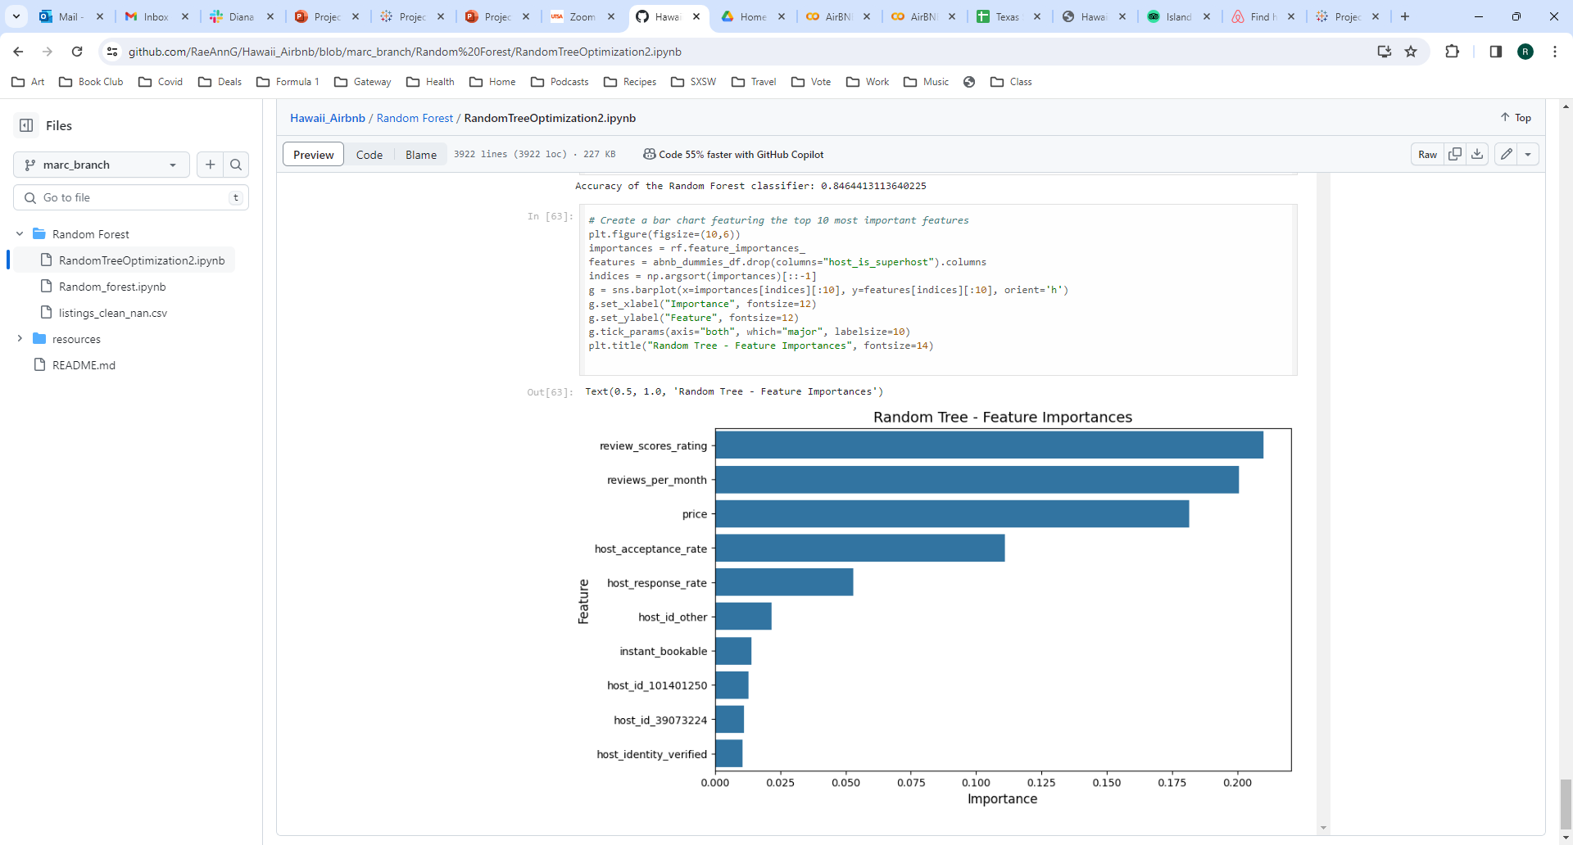
Neural Network – Random Forest with Host ID
Achieved 85% Accuracy
6th Model
Random Forest
Used default values
8 features
Notes:
Rae Ann

Slide 19
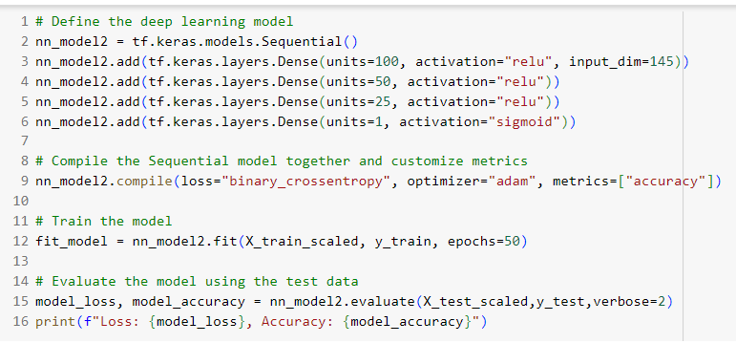
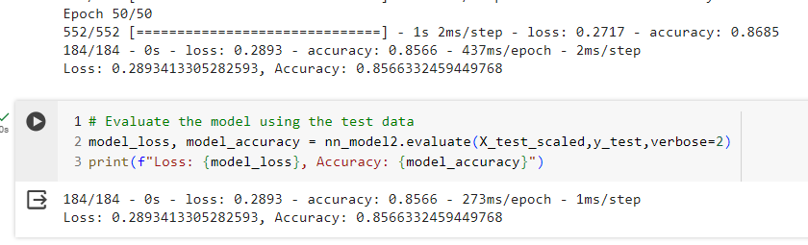
Neural Network – Updated layers and adjusted binning
Achieved 86% Accuracy
7th Model
Adjusted binned Host ID's
Changed cut off to 25 rentals
Adjusted layers
8 features
4 layers
1st layer – 100 neurons
2nd layer – 50 neurons
3rd layer – 25 neurons
Final layer – 1 neuron
50 epochs
Notes:
Rae Ann

Slide 20
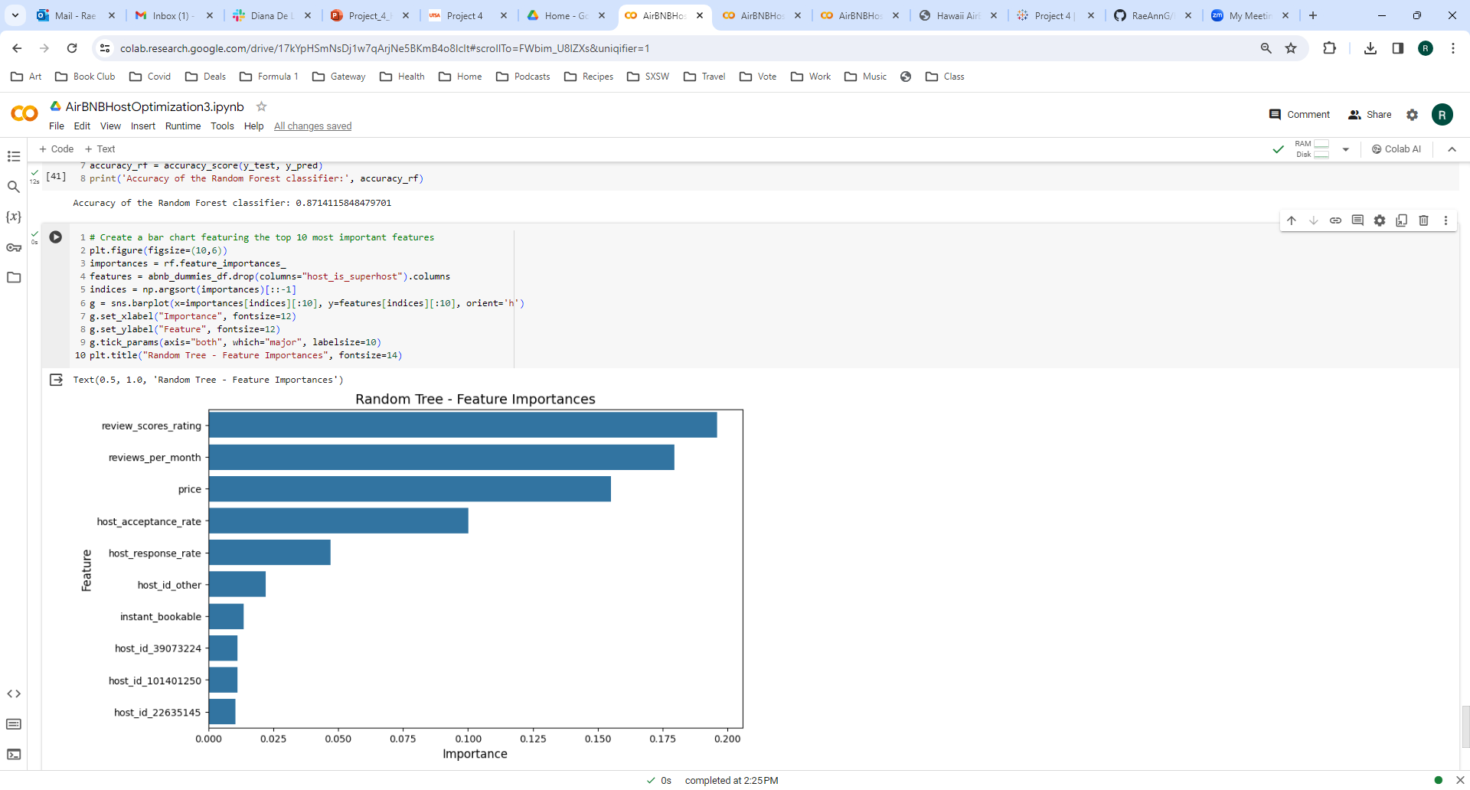
Neural Network – Random Forest Updated
Achieved 87% Accuracy
8th Model
Random Forest
Used default values
8 features
Notes:
Rae Ann

Slide 21

Hawaii – Webpage Presentation
https://raeanng.github.io/Hawaii_Airbnb/

Slide 22
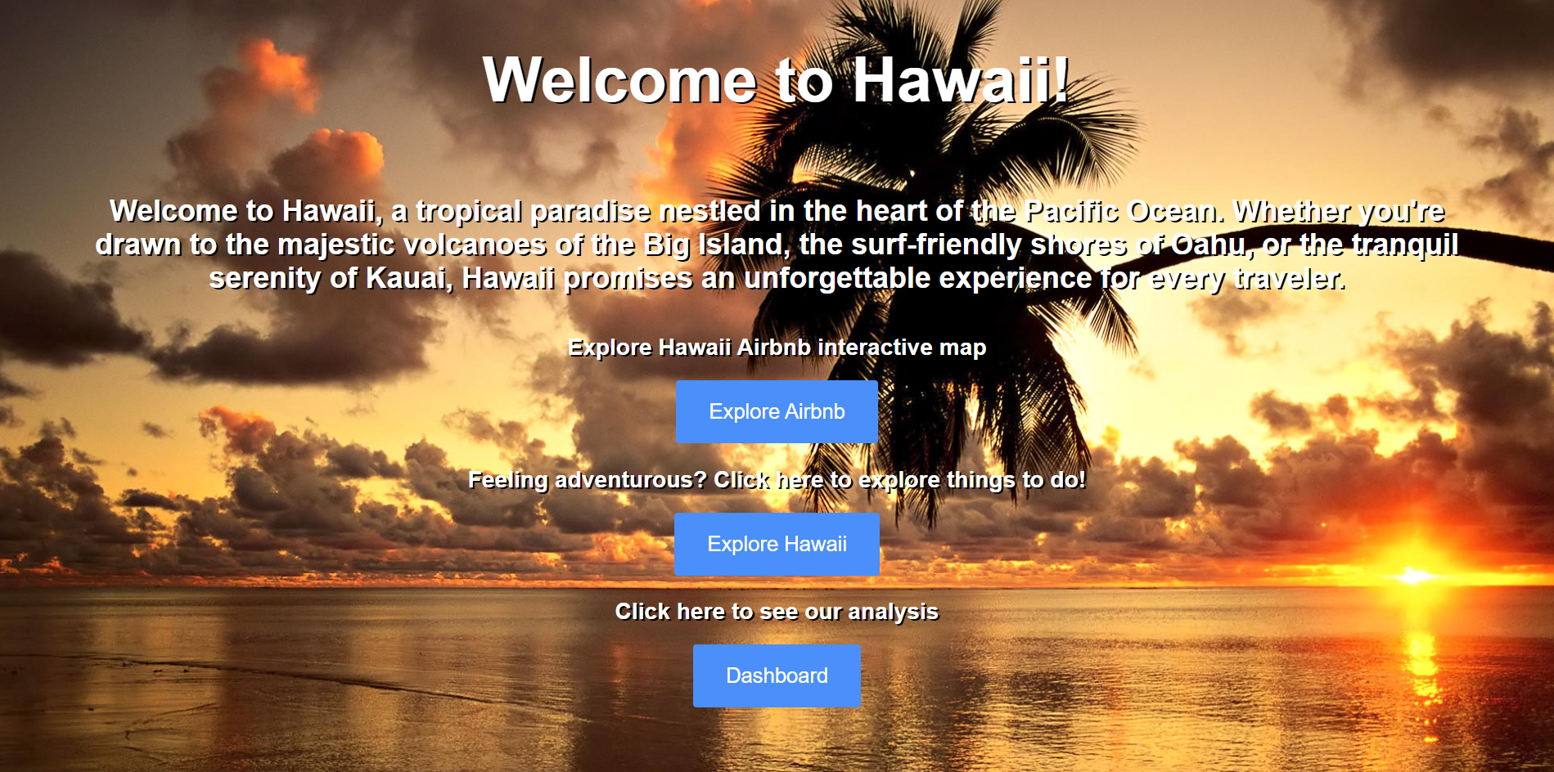

Slide 23
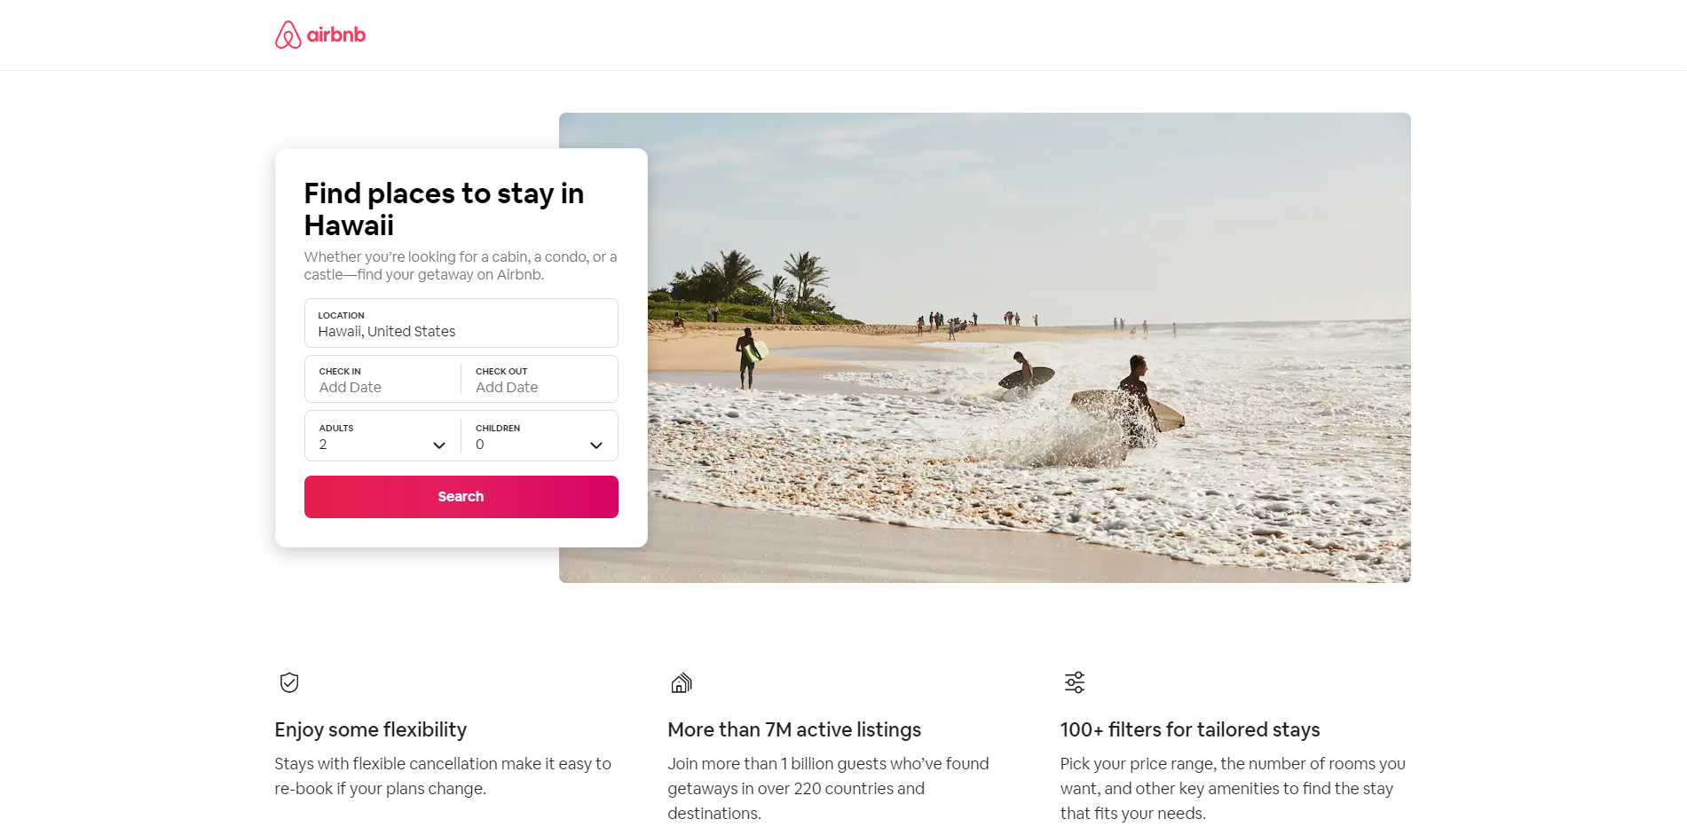

Slide 24
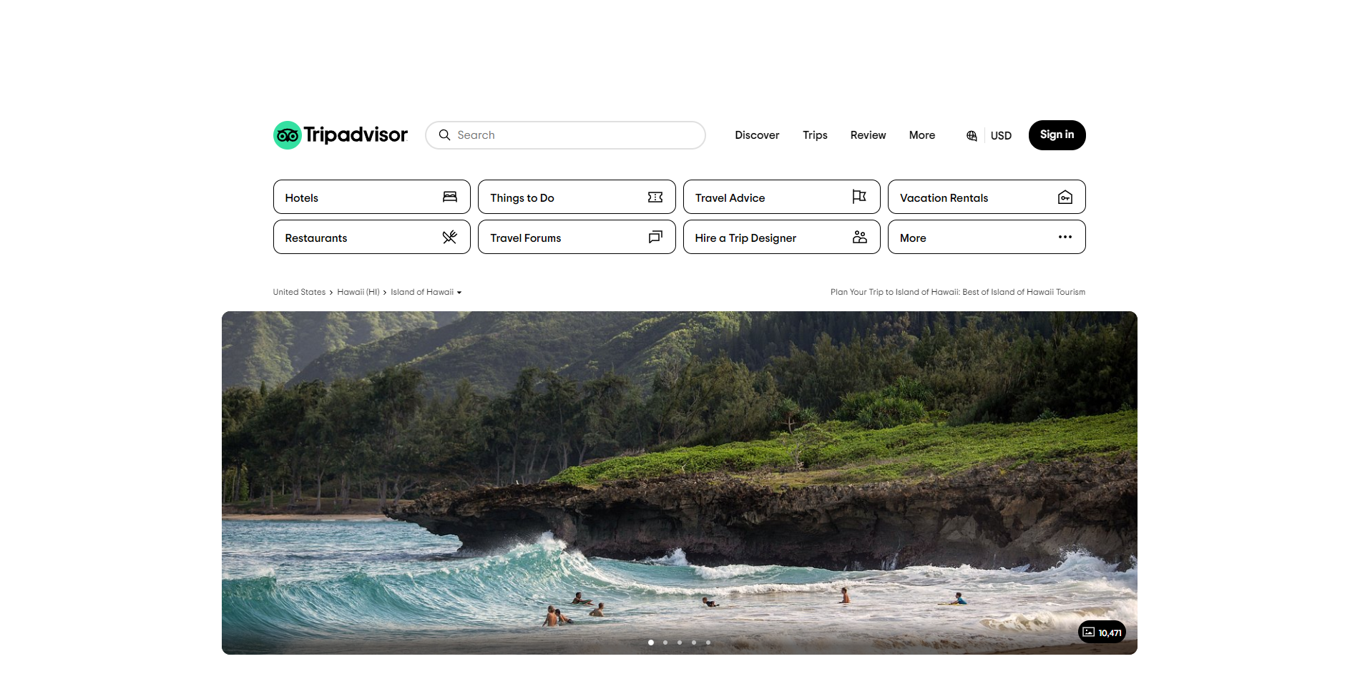

Slide 25
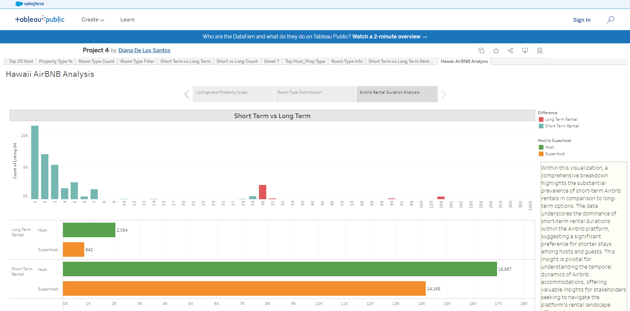

Slide 26
Data Analysis Dashboard
Hawaii Airbnb
Super Hosts
Notes:
Emilia

Slide 27
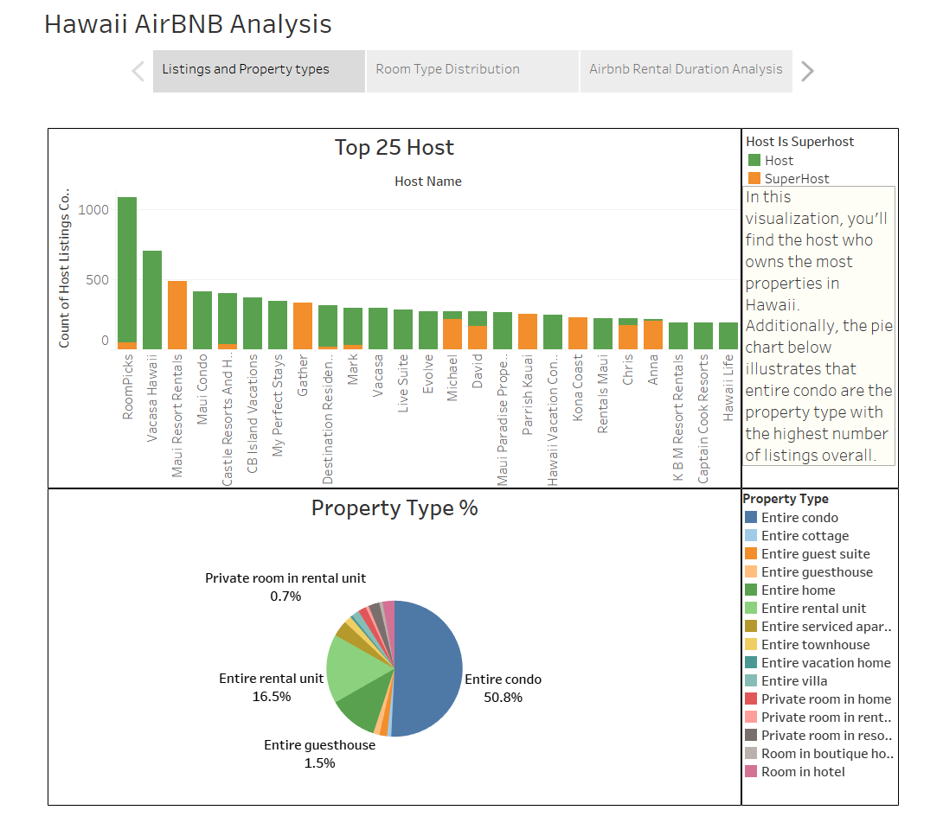
https://public.tableau.com/app/profile/diana.de.los.santos/viz/Project4_17109871260380/HawaiiAirBNBAnalysis
Notes:
Diana -

Slide 28
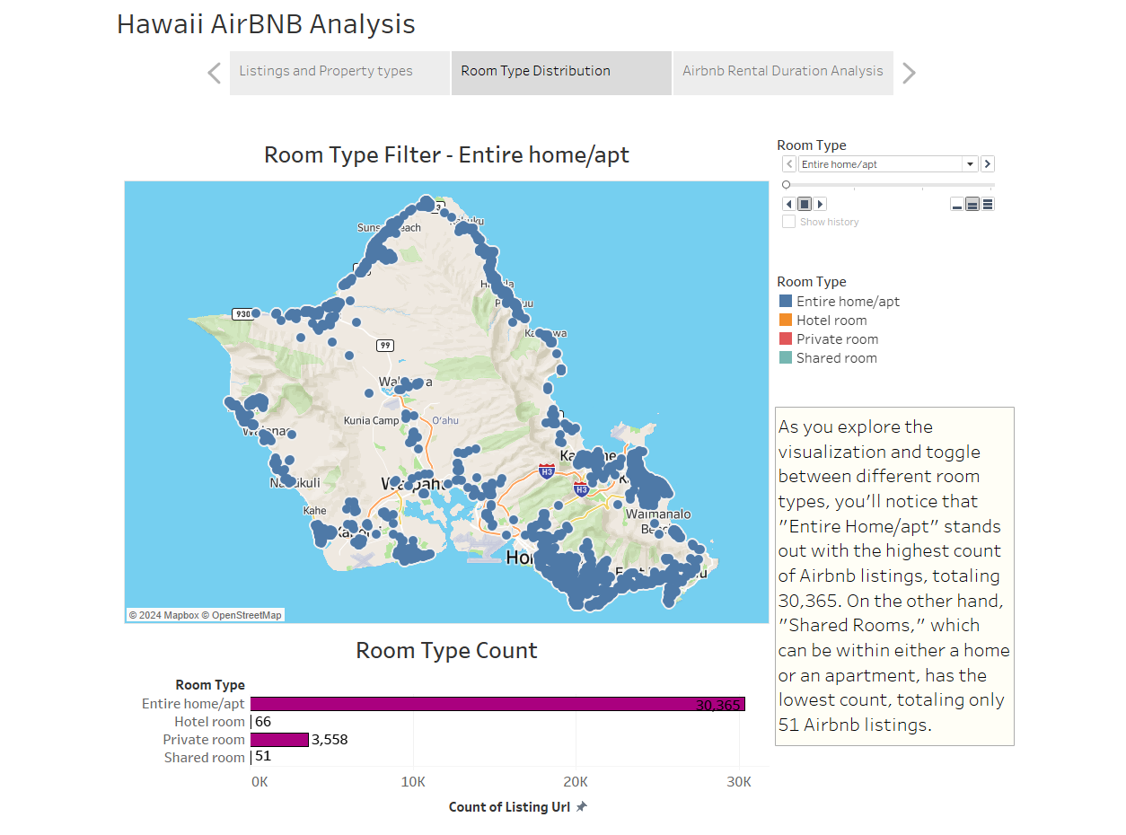
Notes:
Marc

Slide 29
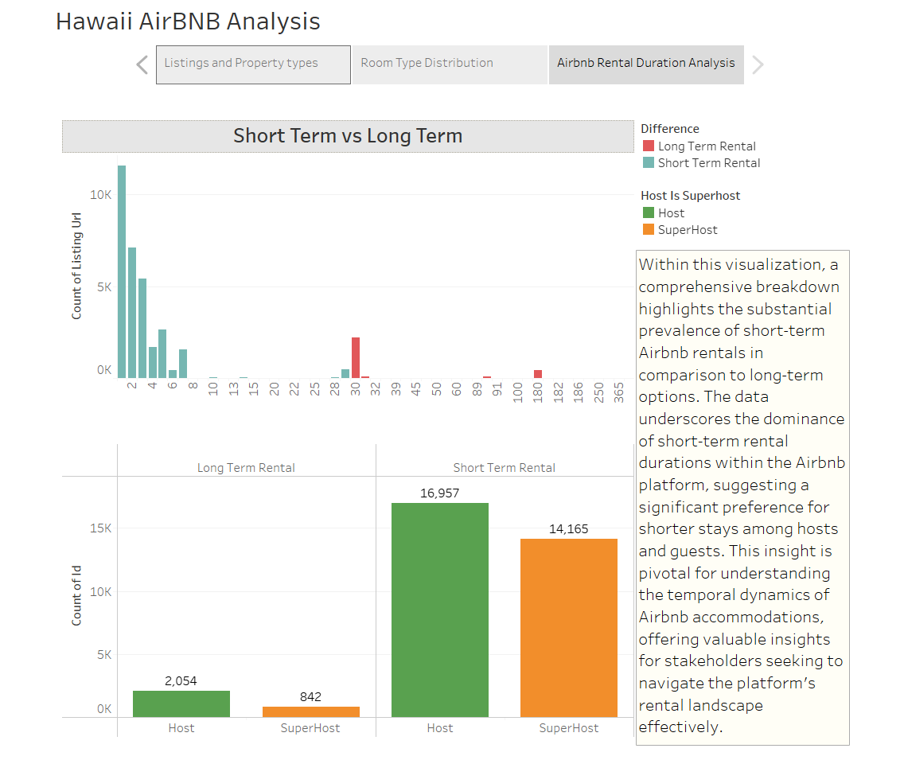
Notes:
Marc

Slide 30
Hawaii's Airbnb Landscape:
Insights and Analysis ​​
Hawaii's Airbnb Landscape:
Insights and Analysis ​​​
MAHALO!
Notes:
Rae Ann

